Slide 1
craftsmanship
What is it and why is it important?

Slide 2
crafts·man·ship ˈkraf(t)smənˌSHip/
Craftsmanship is the quality that comes from creating with passion, care, and attention to detail. It is a quality that is honed, refined, and practiced.

Slide 3
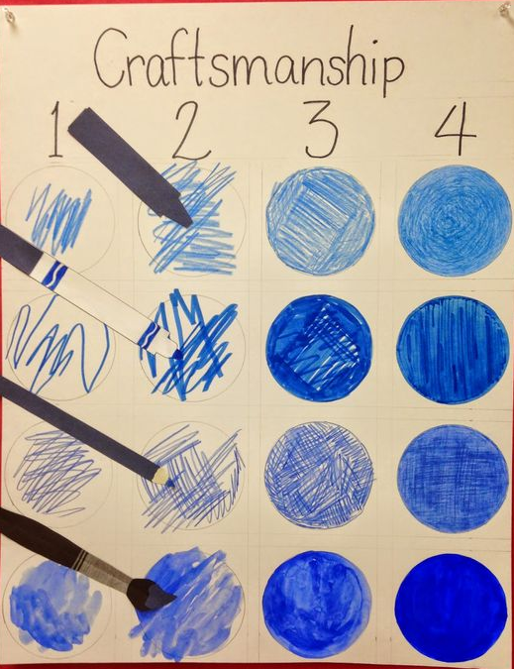
What does craftsmanship look like?
Teacher will type students responses here…

Slide 4
What qualities do you see in this work that demonstrates craftsmanship?
Teacher will type student responses below…
Nicole Eisenman
Beach Runner (Clara)
2014

Slide 5
What does an artist tell the viewer when they exhibit craftsmanship in their work?
Teacher will type student responses below…
Abraham Cruzvillegas
Autoconclusión (for Parkett no. 97)
2015

Slide 6
Why is craftsmanship important to you as an artist?
Teacher will type your responses here…
Nick Cave
Soundsuit
2011

