Slide 1
How do we find meaning in art?
An investigation into the complexities of understanding art

Slide 2
Expectations of this learning experience
You will use the “think, pair, share” thinking routine
Think – take 2-3 minutes to quietly think about the question while taking notes using words and/or images
Pair – take 5 minutes to pair up with one learning partner to discuss your thinking
Share – come together with all learning partners at your table and take 5 minutes per pair to share you and/or your (pair) partner’s thoughts
You will be asked to stretch your thinking
- Take risks
- Encourage your learning partners to think out loud and respect this process

Slide 3
Think, pair, share…
What is something you understand well?
How did you come to understand it?
How do you know you understand it?

Slide 4
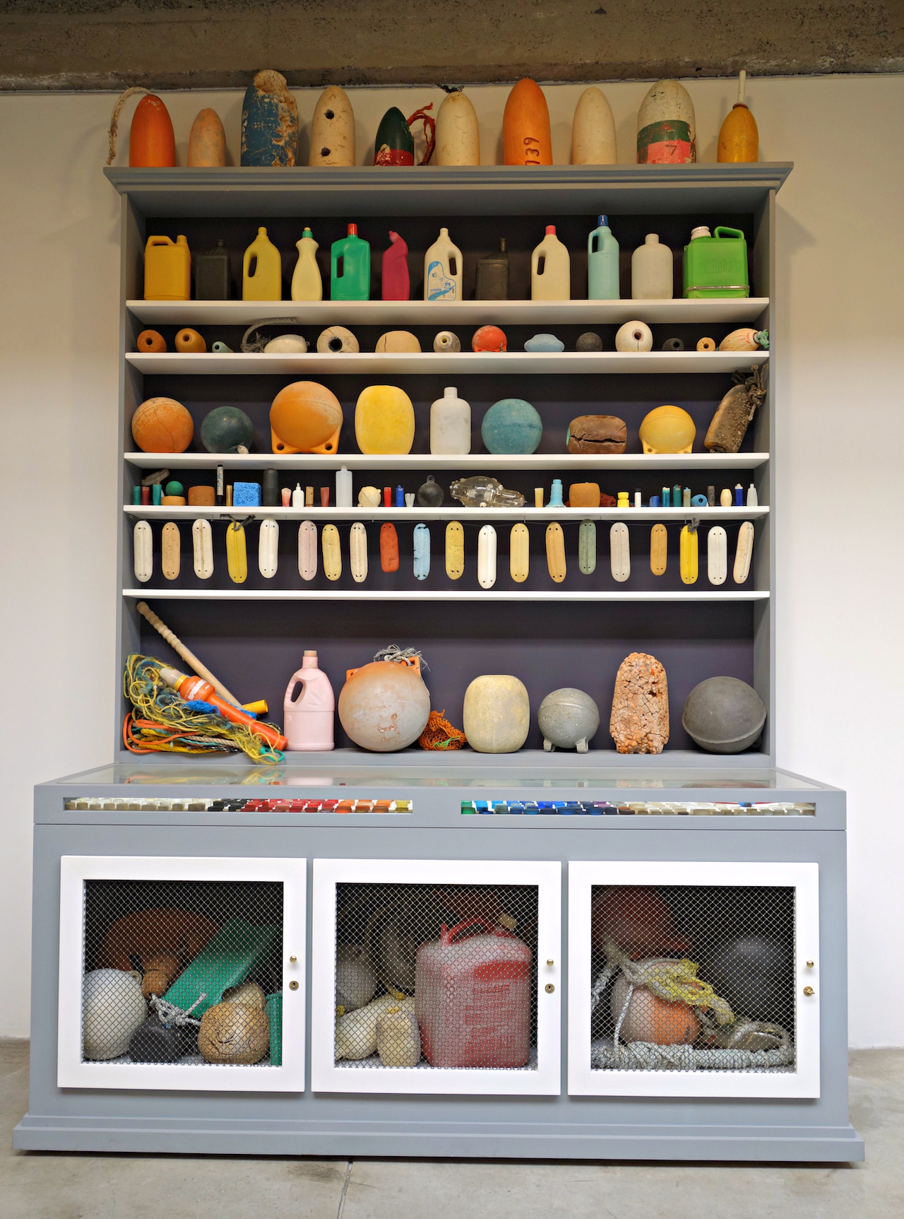
Think, pair, share…
What do you understand about
this work of art?
What do you notice?
What do you feel?
What can you infer?
What curiosities do you have?

Slide 5
Now what do you understand?
Think, pair, share…
How does this information add to your understanding of this work of art?
What information do you now have, that you didn’t have before?
How does this change any interpretations you previously held?
What questions or curiosities do you still have?
Title card:
Mark Dion, Cabinet of Marine Debris, 2014. Wood, class, metal, paint, assorted marine debris, plastic and rope, 113x84x32 inches

Slide 6
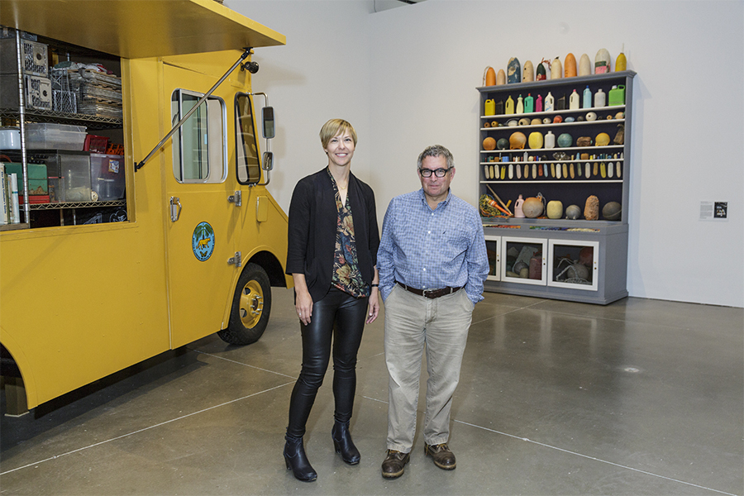
Meet the artist
Click to listen

Slide 7
How did listening to the artist’s story help you to understand?
Think, pair, share…
What information do you now have, that you didn’t have before?
How does this change any interpretations you previously held?
What questions or curiosities do you still have?

Slide 8
Understanding through creating
Directions:
Look (2-3 minutes) back at the image of Cabinet of Marine Debris
Read (2-3 minutes) over your notes on understanding
Choose to do one of the following individually or with a learning partner (10-15 minutes)
Poem
Express your understanding through written word
Use words to express feeling, visuals, information.
Construct your poem in whatever form you would like – this could be haiku, limerick, imagery, freeform, etc. Feel free to use the internet as a resource to find more information about types of poetry.
Drawing
Express your understanding through visual image
Use images to express feelings, visuals and information.
Use any media you would like to create your drawing – pencil, marker, pastel, watercolor pencil, etc.

Slide 9
Share
Directions:
Pair with another group or individual at your table.
Either read your poem or give the viewer(s) 1-2 minutes to look at your drawing.
Compliment – offer words to express what you appreciate about the work that they did.
Question – ask questions about their understanding. i.e.: “What made you choose these words?” or “Why did you use that medium?”

Slide 10
Reflect
Directions:
Answer the following questions using words and/or visuals.
Take 10-15 minutes.
How did this learning experience shape your thinking about understanding?
How do artists communicate?
As an artist, what are some barriers to the way in which you communicate? In other words, what problems have you encountered when you’ve wanted to communicate a thought or an idea through art?
How have these barriers inhibited your viewers from understanding your art?

